Slide 1

Contextual Design
Miguel Castillo
Notes:
Hi everyone, thank you for being here today. My name is Miguel, and I will be presenting on Contextual Design. In this presentation I will give an overview of what Contextual Design is, it's background, key principles and view at the end to end process. I would like to start with this 5-minute video, which provides insight into of how understanding context can help design better and more meaningful technology.

Slide 2

To better design tech, understand context - tania Douglas
Notes:
One example that stood out to me was the project aimed at addressing hearing loss in elderly people. The students initially believed they would develop a better hearing aid. However, through conversations with elders, healthcare providers, and caregivers, this was not the problem. Instead, personal and social perceptions and environmental factors were the real issues. I think the examples provided in this video help put into perspective what Contextual Design is.

Slide 3
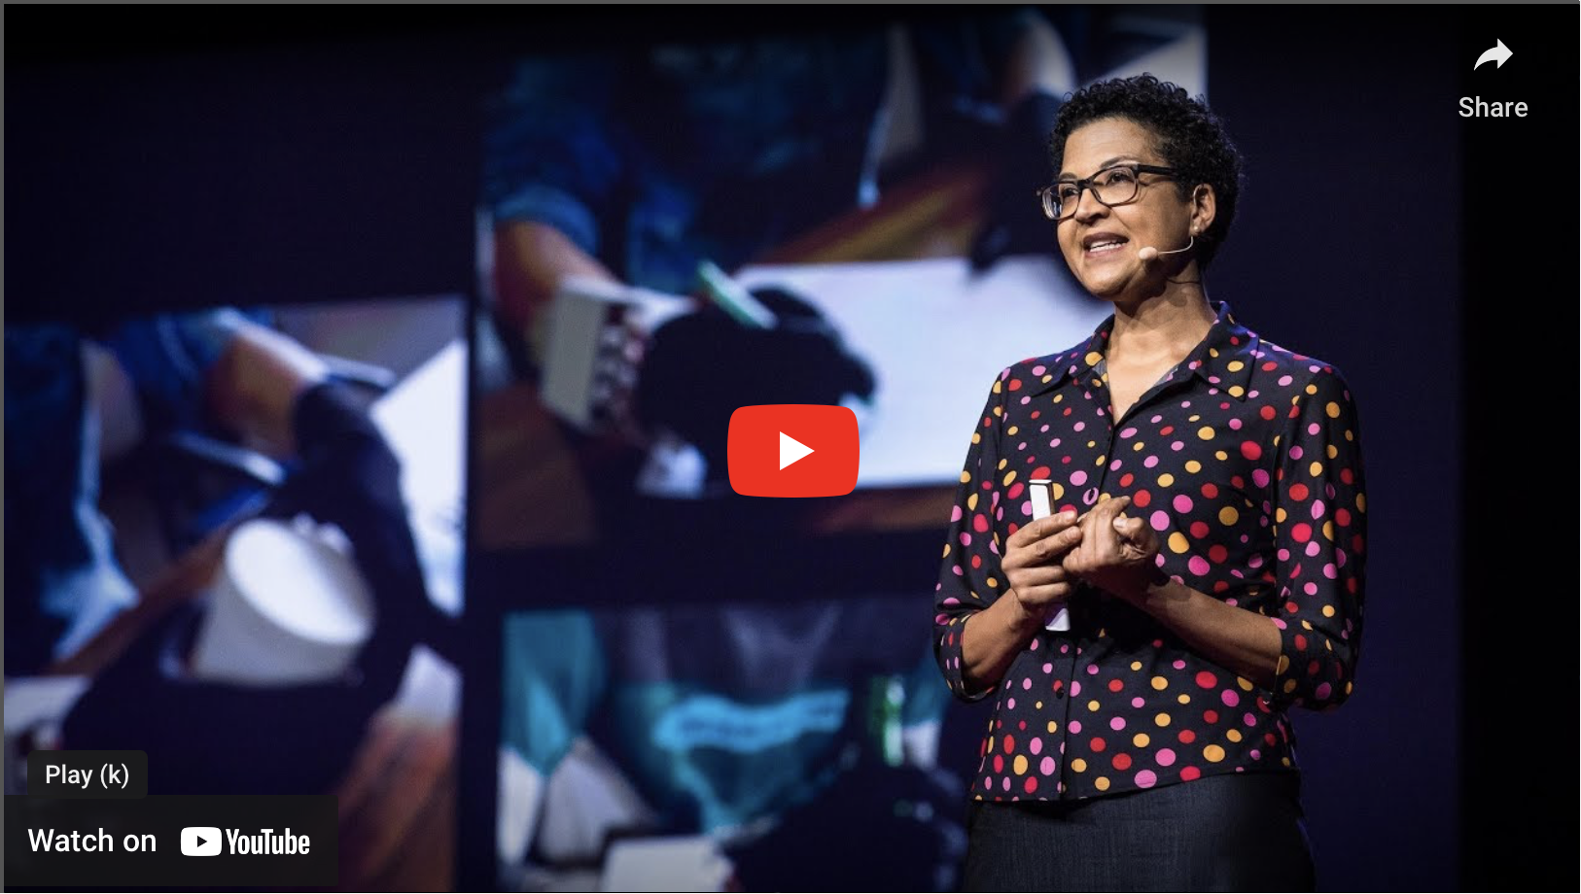
To better design tech, understand context - tania Douglas
Notes:
One example that stood out to me was the project aimed at addressing hearing loss in elderly people. The students initially believed they would develop a better hearing aid. However, through conversations with elders, healthcare providers, and caregivers, this was not the problem. Instead, personal and social perceptions and environmental factors were the real issues. I think the examples provided in this video help put into perspective what Contextual Design is.

Slide 4
What is contextual design?
Contextual Design
A structured, well-defined user-centered design process that provides methods to collect data about users in the field, interpret and consolidate that data in a structured way, use the data to create and prototype product and service concepts, and iteratively test and refine those concepts with users.
User-Centered Design
An iterative design process in which designers focus on the users and their needs in each phase of the design process. In UCD, design teams involve users throughout the design process via a variety of research and design techniques, to create highly usable and accessible products for them.
Notes:
Interaction Design Foundation Website
Contextual Design is a methodology/approach used to accomplish user-centered design, where going out into the field and talking to people in their natural environment is essential to fully understand users' fundamental intents, desires, and drivers. Because even though users may be experts in what they do, they often struggle to articulate what they do, what works well, and what doesn’t. Observing them in their natural environment and asking questions as they go along their day/tasks, provides richer insights.
Design Thinking
Participatory Design
Interviews

Slide 5
background
Founders
Karen Holtzblatt (Psychologist)
Hugh Beyer (Developer)
Created in response to the limitations of usability testing
Techniques are like those of an ethnographic study, but constraint by the limitations of the design project
Notes:
Karen Holtzblatt and Hugh Beyer first developed the key parts of the Contextual Design process in the early 1980s.
At the time, products were being developed in isolation by developers and tested via usability methods focused on lab-based quantitative measures. However, these techniques lead to lmisinterpretations and limited insights and design directions.
Karen introduced techniques from psychology, sociology, and ethnography in response to these limitations, emphasizing the importance of understanding users in their natural work environments. This approach aimed to truly understand what should be made, rather than simply testing what had already been created.
The resulting techniques are similar in nature to an ethnographic study. However, contextual inquiry is constrained by the limitations of an engineering project.
- So field interviews are restricted to a few hours, not days or weeks, and the interaction between interviewer and user is defined as a focused conversation. The purpose of the conversation is to reveal and articulate the nature of the user's work practice, and this purpose is understood and shared by both participants.

Slide 6
Key principles
System must support and extend user’s work practice
Expertise does not equal the ability to articulate current work practices
Design must take place in partnership with users
Good design is systematic
Design depends on explicit representation
Notes:
To create a successful product, first be aware of users' work practice and design for it explicitly.
- If it does so well, it will be accepted and valued; if it fails to do so, it will cause dissatisfaction, frustration, avoidance, and workarounds
However, holding expertise does not necessarily make them experts at communicating what it is they do.
- Use field interviews to reveal tacit aspects of users' work practice - the motivations, workarounds, and strategies that they may never articulate, but structure their work.
Contextual Design is not pure ethnographic observations but involve the user in discussion and reflection on their own actions, intents, and values.
- Don't just observe when you're in the field. Ask questions and suggest interpretations of the user's actions and motivations. Articulate what matters about the work together.
Think about the entire system, rather than treating each part as its own independent problem to be solved.
- Use concrete representations to maintain system coherence: function, structure, layout, and flow across the system.
Use drawings, sketches and models to capture key design considerations at every step of the process.
- Drawings enable designers to work out their ideas, capture their thinking, share it with others, discuss it, and identify weaknesses.

Slide 7
process
Requirement and Solutions
Contextual Inquiry
Interpretation Session
Work Models and Affinity Diagramming
Visioning
Define and Validation Concepts
Storyboards
Interaction Patterns and User Environment Design
Paper Prototype Interviews
Interaction & Visual Design
Notes:
So, what does the process look like? Pretty much it’s divided into two main sections.
Requirement and Solutions
These initial parts are aimed at creating a structured representation of the users work practice that is actionable for design.
Understand what matters to users, categorize what they do and start producing ideas and direction
Define And Validation Concepts
These parts are aimed at working out the details of the design concepts developed in the first half of the process by way of iterative prototype with users.
Redesign activities and technology to provide value and iterate the system with users

Slide 8
1. Contextual inquiry
Talk to and observe users in the field
Understand who’s the user
End user (most of the time)
Indirect user
Managers
Field studies yield what users actually do and care about
Notes:
Conduct one on one field interview with users in their natural environment to discover what matter in their work
- These field interviews are not traditional question and answer interviews with predefined questions
Instead, you want to observe users as they work and inquire into the users' actions as they unfold to understand their motivations and strategy
These session usually last 2 hours
It’s important to understand who is the user, those that will use the solution. Most of the times it’s the end user, however, its important to consider and evaluate the needs of the other users such as indirect users (provide information or use their output) and manager (purchase the product and are responsible for their success.
The interviewer and user, through discussion, develop a shared interpretation of the work. It is like an active inquiry into the user's world. This inquiry, done in context, is where Contextual Inquiry gets its name.

Slide 9
2. Interpretation session
Interpret the data as a team to capture key issues and model activities
Work Models
Flow Model
Cultural Model
Sequence Model
Physical Model
Artifact Model
Create a shared perspective of the data and implications
Notes:
Interpretation sessions lets everyone on the team hear the whole story of the interview
Through these discussions, the team comes to understand the user, their needs, motivations, while at the same time capturing issues, developing a shared understanding of the user's world. Here, work models are developed. These Models are used to capture the work of individuals and organizations in diagrams. These include:
Flow model
Capture communication and coordination between people to accomplish work
Cultural model
Captures culture and policy that constrain how work is done.
Sequence model
Shows the detailed steps performed to accomplish each task important to the work.
Physical model
Shows the physical environment as it supports or gets in the way of the work.
Artifact model
Shows the artifacts that are created and used in doing the work.
Overall, this allows the team to
Shared perspective of data
Avoid designing based on personal or external preferences, instead using data-driven decisions.

Slide 10
3. Work models and affinity diagram
Consolidate data across users for a full view of:
Key issues
Tasks
Values
Collaboration
Find opportunities to guide innovation
Personas
Notes:
Systems are seldom designed for a single user. But designing for a whole user population - depends on seeing the common aspects of the work different people do.
Consolidation brings data from individual user interviews together so the team can see common pattern and structure without losing individual variation. The affinity diagram brings together issues and insights across all customers into a wall-sized, hierarchical diagram to reveal the scope of the problem
Together, the affinity diagram and consolidated work models produce a single picture of the customer population a design will address. They give the team a focus for the design conversation, showing how the work hangs together rather than breaking it up in lists. They show what matters in the work and guide the structuring of a coherent response, including system focus and features, business actions, and delivery mechanisms.
Here there is also an opportunity to developed personas. Contextual Design personas are built from the detailed data gathered through Contextual Inquiry interviews, so they have the richness and depth needed to drive design.

Slide 11
4. visioning
Facilitate group ideation session
Print out data set and place on wall
First immerse in the data then generate concepts for new and existing products
Vision captures a story of how users will do their work in the new world the team invents
Vision includes the system, its delivery, and support structure
Notes:
In visioning, the team uses the consolidated data to drive conversations about how to improve users' work by using technology to transform the work practice.
This is done by facilitating a group ideation session
Where people walk around interacting with the data and place design ideas on the data
Design ideas will emerge
New people can come in
This will help in identifying key issues, what can be done or not
This focuses the conversation on how to improve people's lives with technology, rather than on what could be done with technology without considering the impact on peoples' real lives.
Then story telling will begin
Capturing how users will do their work in the new world the team invents. A vision includes the system, its delivery, and support structures to make the new work practice successful. It is intentionally rough and high-level - a vision sets a possible design direction, without fleshing out every detail. This enables the team to see the overall structure of the solution and ensure its coherence.

Slide 12
5. storyboards
Develop the details of the new to be activities
Clarify function, user experience, automation, rules, data, and technology based on the vision
Notes:
Afterwards, you take the the high-level structure and break it down to make it actionable. This next level of design must take the users' tasks into account and ensure the right function is defined in the right system places for a smooth workflow.
Each storyboard describes how users will accomplish a task in the new system. They show the steps the user will take and the system function that supports each step. The task may be handed off between users and may be supported by several systems operating together; the storyboard ensures the task remains coherent across these boundaries.

Slide 13
6. Interaction patterns and user environment design
Represent the system structure, requirements, and user interface layout
Ensure consistency, and smooth user experience product wide
Notes:
The storyboards ensure coherence of individual tasks, but the new system must have the appropriate structure to support a natural flow of work through the system no matter what task the user is doing.
To do this the User Environment Design needs to be developed.
The User Environment Design captures the floor plan of the new system. It shows each part of the system, how it supports the user's work, exactly what function is available in that part, and how the user gets to and from other parts of the system - without tying this structure to any particular user interface.

Slide 14
7. Paper prototyping
Mockup the interface to validate direction and UI with users
Validate product concepts, process changes, user experience
Have users live their lives inside the mockups
Notes:
Now before proceeding with the development, it’s important to test and see if anyone will like what’s been created
To do this, you want to
Go back into the field and have people live their real lives inside the mockups
No scenarios or redefined tests
Have them replay their lives inside the mockup (what did you just buy)
When the user discovers problems, they and the designers redesign the prototype together to fit their needs
Refining the design with users gives designers a user-centered way to resolve disagreements and work out the next layer of requirements.

Slide 15
8. Interaction & visual design
Define the visual design and test with users
Notes:
After several rounds of prototyping, the larger structure of the system design stabilizes. At this point, the design team can continue iterating areas of the user interface.
Once the structure and interaction design are largely stable, the team can develop and test interaction and visual design options with users.

Slide 16
Thank you
Thank you very much for your time! If you have any questions, please contact me via - cast4317@vandals.uidaho.edu

Slide 17
References
Holtzblatt, K. and Beyer, H. R. (2014, January 1). Contextual Design. Interaction Design Foundation - IxDF. https://www.interaction-design.org/literature/book/the-encyclopedia-of-human-computer-interaction-2nd-ed/contextual-design
Holtzblatt, K. (2022). Contextual Design. InContext Design. https://www.incontextdesign.com/cd/
Douglas, T. (2018). To design better tech, understand context . YouTube. https://www.youtube.com/watch?v=eemOZfsrKdg

